Slide 1
WELCOME TO MY FINAL YEAR PROJECT PRESENTATION
MSGR.FELICIEN MUBILIGI TVET
OPTION: COMPUTER SCIENCE
ACADEMIC YEAR: 2018
TITLE: PAYROLL MANAGEMENT SYSTEM
CASE STUDY: KABUYE SUGAR
Submitted By UWIRINGIYIMANA jeannine
Supervised By TUGUME kitunzi Stephen

Slide 2
ORGANISATION OF THE PROJECT
The work is divided and organized in six chapters:
Chapter one deals with the general introduction of the project.
Chapter two is merely the literature review.
This one is concerned with the consultations of existing literature
in this field of study.
Chapter three is the Methodology used in research.
Chapter four includes system analysis and design of the system
Chapter five is the implementation of the new system.
Chapter six will give the general conclusion as well as some recommendations

Slide 3
ABSTRACT
In this world we live, information and Communication Technology is playing a major role in the Development of the world, the society and the way people do their jobs including communication field.
payroll will be useful to the companies that have many employees because it will be easy to manage, pay many employees at the same time .
This system will also help to decrease disagreement between manager and employee in process of giving employee punishment.
The World Wide Web uses many languages to develop and perform tasks on websites. The most common languages are html, php, java cold fusion, xml, etc. to facilitate the work to programmers, and many other tools have been developed to help programmers. These tools are for example XAMPP

Slide 4
GENERAL INTRODUCTION
Information system technology is widely used and is rapidly becoming a common asset of modern socio-economic life in this new world.
I decided to orient my research in developing a Payroll System
that would help and replace the existing paper based systems and
it would reduce tasks and time taken by the staff to pay the recorded
information into computers.
All this will be carried under a research topic entitled:
“DESIGN AND IMPLEMENTATION OF A PAYROLL SYSTEM SYSTEM.”

Slide 5
PROBLEM STATEMENT
Speed in processing payroll tends to be slow.
Difficult and time consuming in keeping up-to-date in payments and other deductions. ...
Time consuming in double checking the consistency of all the reports.
Prone to mathematical errors that could consume much time
it should cause financial or legal trouble.

Slide 6
GENERAL OBJECTIVES:
The general objective of this system is to analyze the problems of kabuye sugar employees to get paid easily.
manager will be able to know all employees and their informations.
Full security of the system
SPECIFIC OBJECTIVES :
The specific objective of this project is to develop a system that will be able to store information about Employees registration, payments history and penalties that facilitate the company to know more information and to easily pay many employees in a short and safe way.

Slide 7
SCOPE OF THE PROJECT
The scope of this project is focused to KABUYE SUGAR PAYROLL MANAGEMENT SYSTEM to the time is limited to the employee registration, salary, deductions and assurance.
payroll system can also be used in different companies,
And other institutions to stores all information of employees and pay them

Slide 8
PROJET INTEREST
The development of this project presented the following interests:
To increase the knowledge in ICT application.
To promote information technology applications in various organizations.
To reduce the time of checking payment reports for every employee
To promote security that is refer to the payments of employees

Slide 9
LIMITATION OF THE PROJECT
The system is used by different kinds of employees.
that is why we need to limit certain parts of the project:
Employee can’t access all parts of the system like adding employee, pay employee and others.
This system is not hosted on the internet.
This system has two users, admin and employee

Slide 10
TOOLS USED
Hardware tools:
RAM: 2GB
FLASH DISK: 8GB
PERSONAL COMPUTER with faster speed( Pentium or AMD processor)
HARD DISK: 250GB
Software tools:
Back end
Language: php
Database: MySQL
Text editor: sublime
Xampp is software used for creating dynamic webpages uses languages like php.
Front end
Browser: opera, Mozilla Firefox and Google chrome
Operating system: window 10
Microsoft office: word and PowerPoint

Slide 11
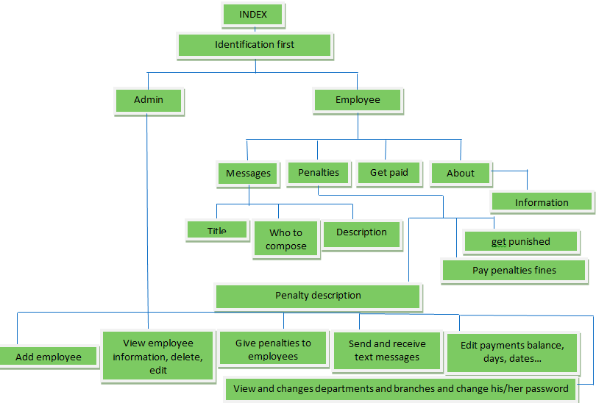
WEBSITE ORGANISATION

Slide 12
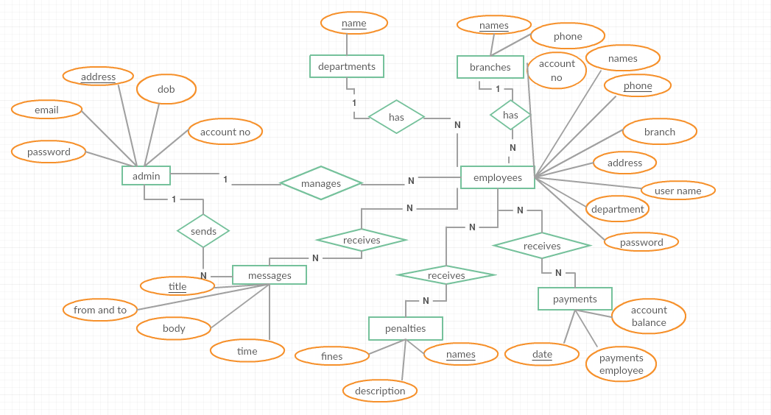
ENTITY RELATIONSHIP DIAGRAM

Slide 13
SYSTEM IMPLEMENTATION

Slide 14
CONCLUSION
According to the world evolution and technology,
as well as the data computerization,
I studied and analyzed the system which can be easier for the user to use
and which is more accurate.
During the realization of my project I used all possible solution to analyze a system
that will facilitate all kabuye sugar employees to get paid easily without spending a
long time.
According to what I want, my project was successfully finished as I wish.

Slide 15
RECOMANDATION
During this work I have met many problems,
firstly the access in laboratory,
secondary the lack of enough documents including books.
For that reason I recommend our school authorities to help students to have enough
materials including books and enough computers and other documents and alsO
give them enough time in laboratory for practice.
I also recommend that this project can be presented to different companies all over
the country.
I finally recommend my young sisters of the computer science department
to extend this project

Slide 16
THANK YOU ALL !!!
MAY GOD BLESS YOU
SUBMITTED BY:
Uwiringiyimana jeannine

